Slide 1
Design Patterns
In nutshell
Alex Beyderman
Software developer

Slide 2
Design Pattern are:
Template for how to solve a problem or implement an idea in source code.
Generally reusable solution of a common problem.

Slide 3
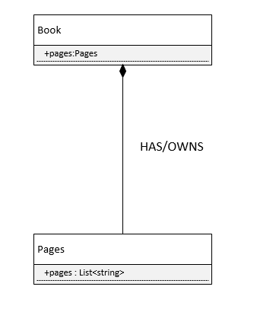
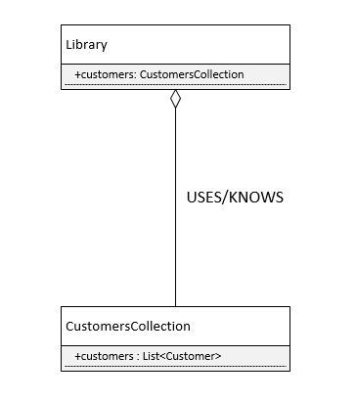
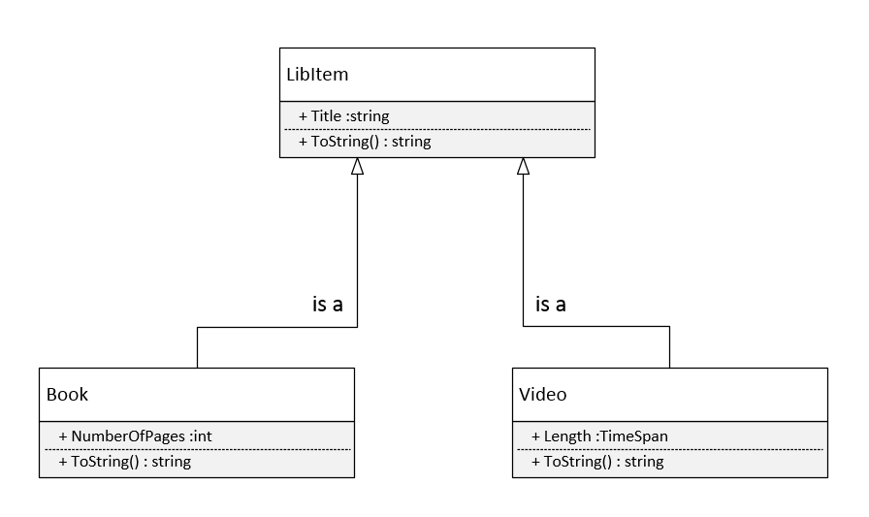
Unified Modeling Language in (very)nutshell
Inheritance
Composition
Aggregation

Slide 4
S.O.L.I.D.
Single Responsibility principle (SRP)
Open/closed principle (OCP)
Liskov substitution principle (LSP)
Interface segregation principle (ISP)
Dependency inversion principle (DIP)

Slide 5
Design patterns types
Creational – designed to abstract instantiation process.
Structural – concerned with how two or more objects are composed into a bigger object.
Behavioral – concerned with algorithms and assigning responsibility between objects.

Slide 6
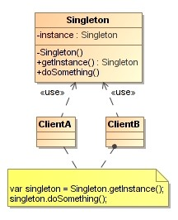
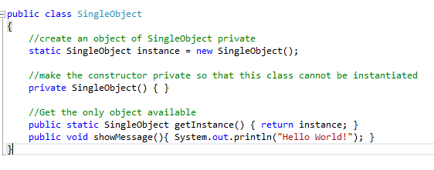
Singleton (creational)
Forces a developer to use only ONE instance of an object for current application life span.
Define
UML

Slide 7
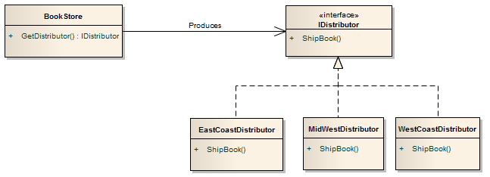
Factory (creational)
Object which acts as creator of other objects

Slide 8
Adapter (structural)

Slide 9
Bridge (structural)
Enables use of different APIs by same type of object
Works like “API injector”

Slide 10
Decorator (structural)
Extends objects functionality

Slide 11
Observer (behavioral)

Slide 12
Examples

Slide 13
Resources

Slide 14
Quiz

Slide 15
Exercises

Slide 16
Part1 – Implement Library main engine
Given:
main method which starts Library application
Task:
Using Singleton pattern make sure the system will always run only one instance of library

Slide 17
Part2 - Implement part of a library registration system
Given:
Book class extending LibItem class
Video class extending LibItem class
Customer class
Task:
Using Bridge pattern implement Registration class that adds new book, video or customer to the library.

Slide 18
Part3 - Implement part of a library tracking system
Given:
Book class extending LibItem class
Video class extending LibItem class
Task:
Using Decorator pattern implement Borrowable class that enables to borrow a book from the library.

